Slide 1
Autoencoders
Learns a representation of inputs. Think: Embedding / PCA
Notes:
Why do such a thing? Whatever you do E/PCA for – e.g. features, dimension reduction…
Explain terminology of architecture. Why auto, why encoder, why decoder.
VAEs- puts in some probabilistic randomness to this – allows generation of data.

Slide 2
VAE is a generative model
Explicitly tries to model p(x). Discriminators try to model p(y|x).
Can be turned into a discriminator / classifier by Bayes Rule. (Tends to have higher error floor than discriminators but converges faster to its ‘best error’)
Sometimes generalizes better – making structural assumptions works as a kind of regularizer
Can be used to generate new data (e.g. new plants for a 3D game to quickly get a ‘forest’)
One of the most important advancements for generative deep learning (the other being GANs)
Notes:
http://cs229.stanford.edu/notes/cs229-notes2.pdf - example on generative vs discriminative
http://robotics.stanford.edu/~ang/papers/nips01-discriminativegenerative.pdf – higher asymptotic error for generative, but faster convergence

Slide 3
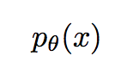
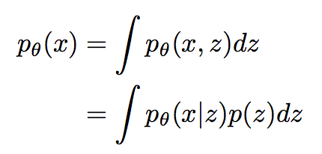
VAE set up
In math, this is what we’re looking for:
We can extend this into a models with latent variables:
In the VAE set up, we declare p(x|z) = NN, p(z) = Gaussian. But integral cannot be done.
P(x|z) here is called the ‘decoder’, since it’s taking some latent variable and describing x based on it.
Notes:
Have a think about why this is so – it is basically the essence of a generative model. Knowing the distribution of your data.
Why extend to a model with latent variables? Gives more flexibility to the model, apparently.
How come the integral can’t be done? Impossible to go through all possible configurations of z.

Slide 4
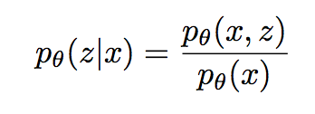
VAE set up
To get around the intractability, define an approximate distribution for p(z|x), which we call the encoder: q(z|x).
Didn’t we just say p(x) was intractable? What has p(z|x) got to do with this? Because by Bayes:
If p(z|x) becomes tractable, so will p(x)
tractable
intractable
intractable

Slide 5
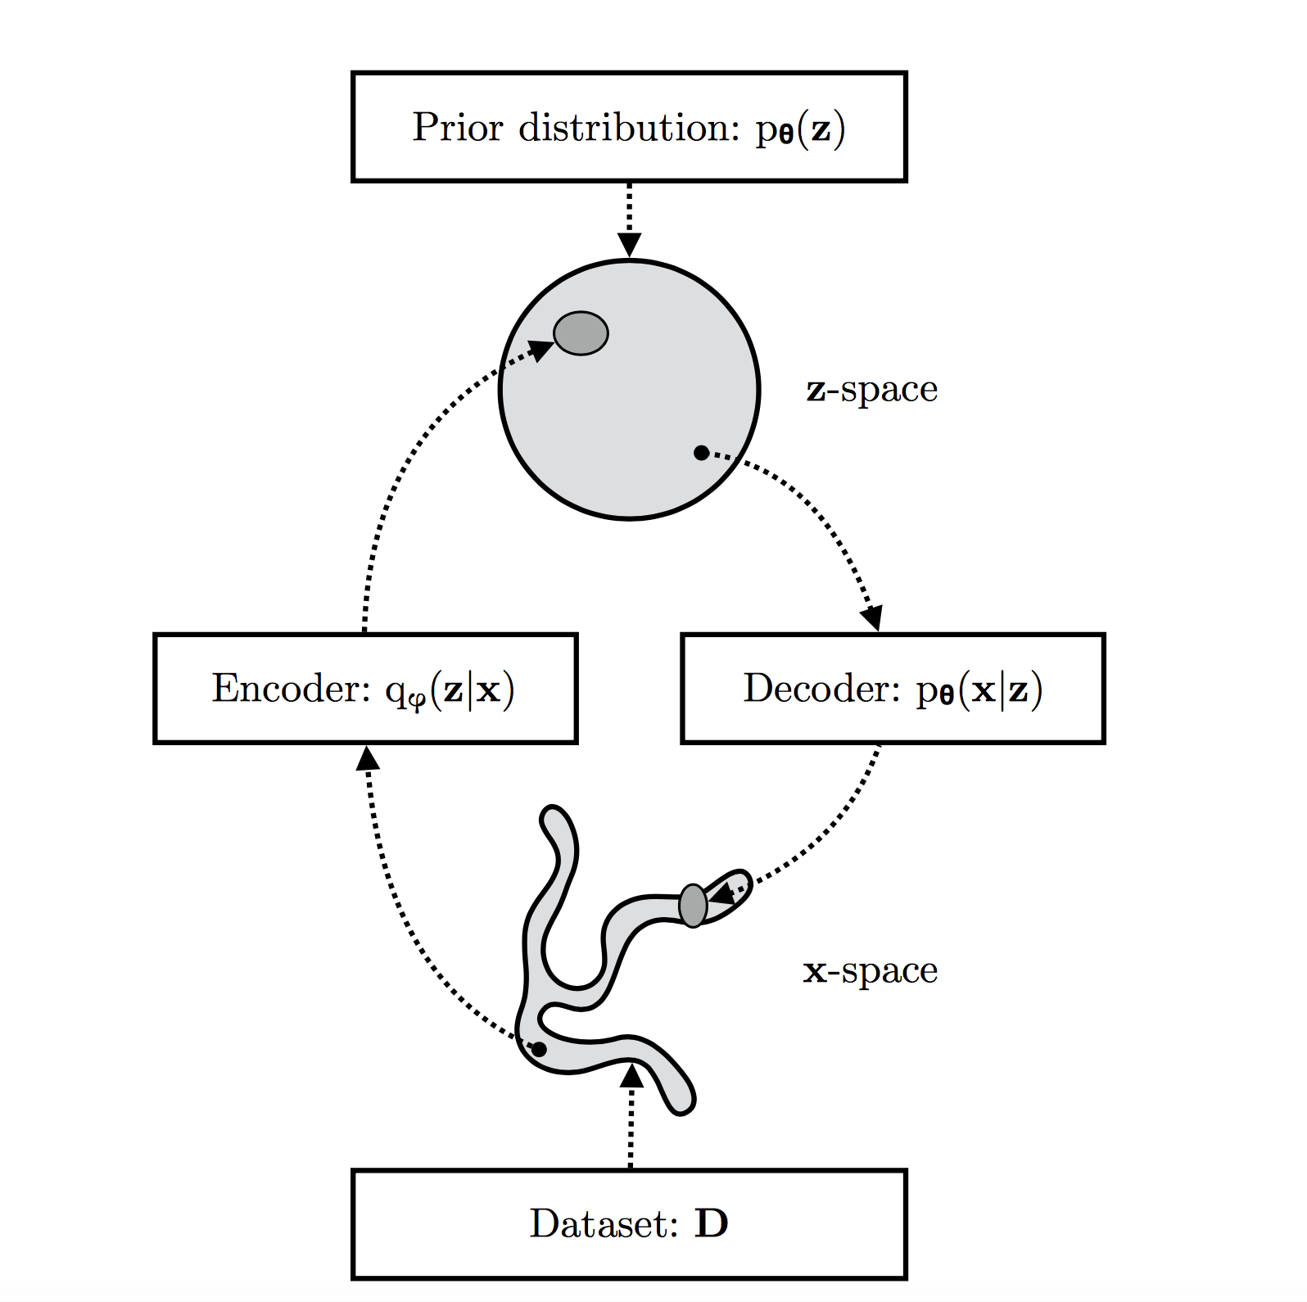

Slide 6
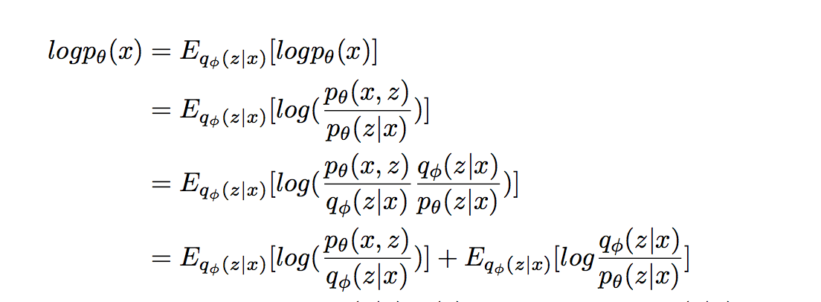
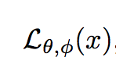
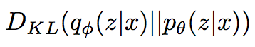
VAE – optimization objective
Optimization is based on the Evidence Lower Bound (ELBO)
ELBO
KL-divergence between q and p
Notes:
LTP, Bayes, Constant, Logarithms
q is an approximation to p. We’ve already decided that we can’t handle p, but at least we know KL >= 0
Why did we write this out? For MLE estimation, always aim to maximize p_theta, likelihood of the data.That’s how we train.

Slide 7
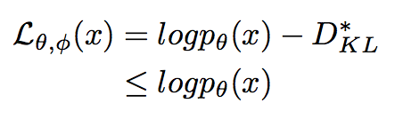
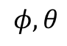
VAE – optimization objective
Because KL-Divergence is at least 0, we have that
So the KL term determines two distances:
The divergence of approximate q from true p
‘Tightness’ - the gap between ELBO and log-likelihood p. The better q approximates p, the smaller the gap.
If we maximize ELBO w.r.t , we optimize two things we care about:
Maximize log-likelihood p, so make the generative model better.
Minimize KL, so that q approximates better
$$φ,θ$$
Notes:
This gives an intuition of how our optimization gets what we want. Next slide is practical implementation of the optimization objective.

Slide 8
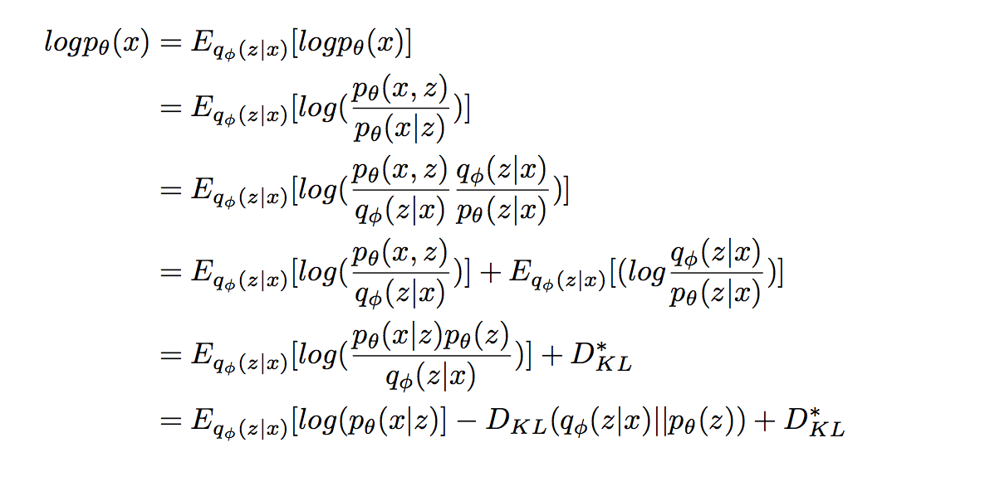
VAE – optimization objective (during training)
MSE (Reconstruction loss)
We chose q and p to be Gaussian, closed form solution
Intractable part, see previous slide
Notes:
D_KL^* is the KL divergence for the intractable portion.

Slide 9
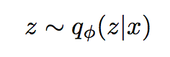
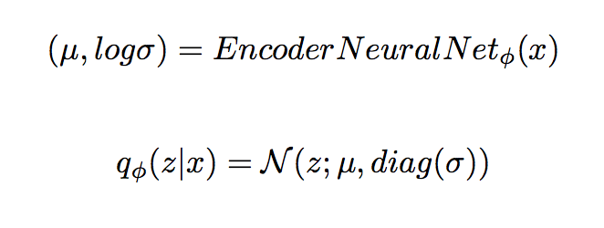
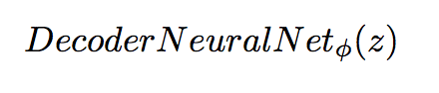
Sampling
KL-loss
Reconstruction loss

Slide 10
Clearer picture(?)

Slide 11
Actual implementation
There are two components of the loss:
Reconstruction loss
KL-divergence
When taking gradients, need to ensure gradients against both losses are summed.
Sampling - you can’t backpropagate through sampling, use the reparameterization trick to externalize the randomness. See paper.
Notes:
Gloss over this.

Slide 12
VAEs for fraud (AXATP)
Send all data points through the VAE network. Those with ‘high’ reconstruction loss are candidates for fraud.
AXATP data
Train/test – use the split provided during development (201803~201805)
Deployed XGBoost model is at AUC ~ 0.97
Notes:
Bearing in mind that VAE is unsupervised while XGB is supervised – what performance do you think VAE should have?
Should we be using reconstruction loss or total_vae_loss?

Slide 13
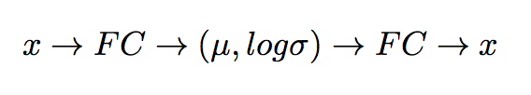
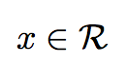
VAEs for fraud (AXATP)
Architecture:
KL-loss – Assume two Gaussians, closed form solution
RC-loss – , so take MSE
Scale? Should, since MSE.
All features? Probably not, use just the top ones. How many neurons in hidden layer? How many latent variables? What about learning rate?
Optimization schedule – use ADAM.
For training, use only fraud_flag = 0

Slide 15
Conclusions
Features – small number but quality features are best.
Sensitive to scale, don’t think it handles categorical features well(?)
Hidden neurons – the more the better.
Latent variables – not much difference between 10 and 1000. Might be a function of input dimension.
AUC is lower, but keep in mind that our architecture is very simple, just two FCs. (And VAE is unsupervised too)
Scaling helps, but MinMax (with sigmoid) doesn’t help. Hinting that Batch Normalization will help with performance too?
ADAM seems to break if minima is reached very quickly, but still a lot of rounds/epochs to go.
Learning rate is ‘the most important hyperparameter’. A perfectly fine implementation might look like it bugged out with poor choices of learning rates.
KL-weight could be tuned for more realistic data point generation, YMMV.
For China, the encoded features (10-dim) were not adding any value to the existing model.
Personal – plenty of bugs, always have someone to discuss with if possible.
Notes:
(?) – e.g. trees can slash out regions of high probability, don’t think VAEs can since it is based on reconstruction (blind to the suspicion structure). Can be tested by artificially creating a dataset with regions of suspicion and see how VAEs handle it.

Slide 16
Readings
ADAM paper https://arxiv.org/pdf/1412.6980.pdf
VAE (original) https://arxiv.org/pdf/1312.6114.pdf
VAE (deeper, expansion of original) https://arxiv.org/pdf/1906.02691.pdf
VAE (tutorial, high level) https://towardsdatascience.com/intuitively-understanding-variational-autoencoders-1bfe67eb5daf
VAE (tutorial, math-y) https://arxiv.org/pdf/1606.05908.pdf
Probabilistic Graphical Models (Koller & Friedman), in our library. Doesn’t directly touch on VAE, provides foundation for the probabilistic motivation to VAEs.
Notes:
Fun fact – DP Kingma was in both ADAM and original VAE

